Slide 1

Treadmill Buyer Profile Analysis
Understanding Consumer Segments for Treadmill Purchases

Slide 2
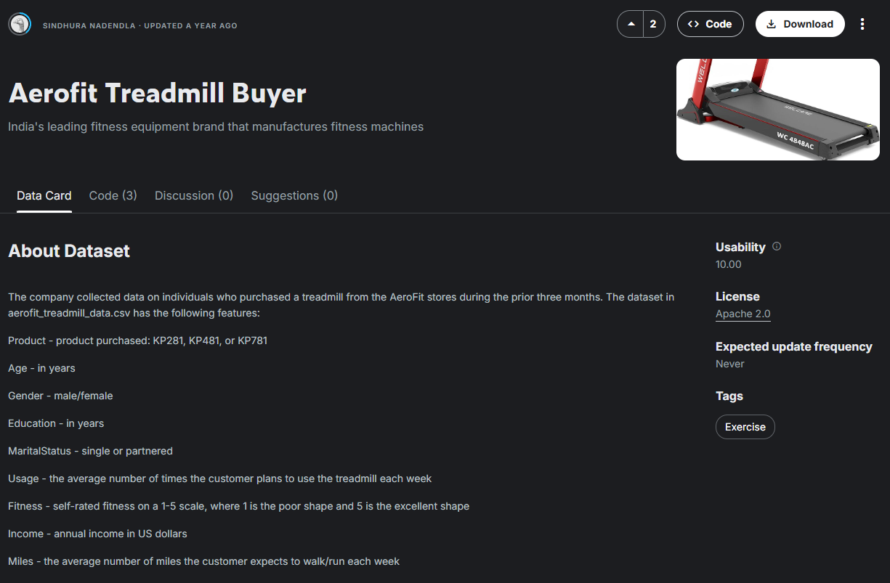
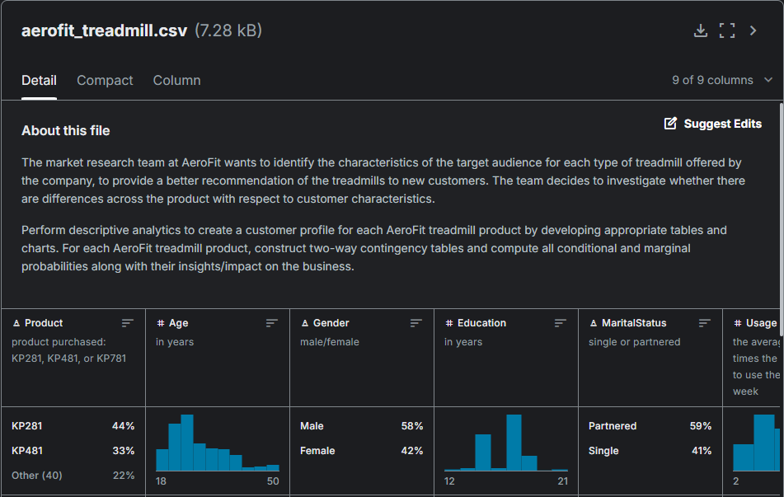
Project Background
Problem Statement: What are the key characteristics of treadmill buyers and how can they be leveraged to improve sales?
Dataset:
Kaggle Aerofit Treadmill Buyer Dataset
Contains demographic and purchasing behavior data.
Data Set Parameters
9 columns
180 purchase records
Goal: Segment customers based on their preferences and buying habits.
Kaggle Data Set Landing Page
Kaggle Data Details Preview

Slide 3
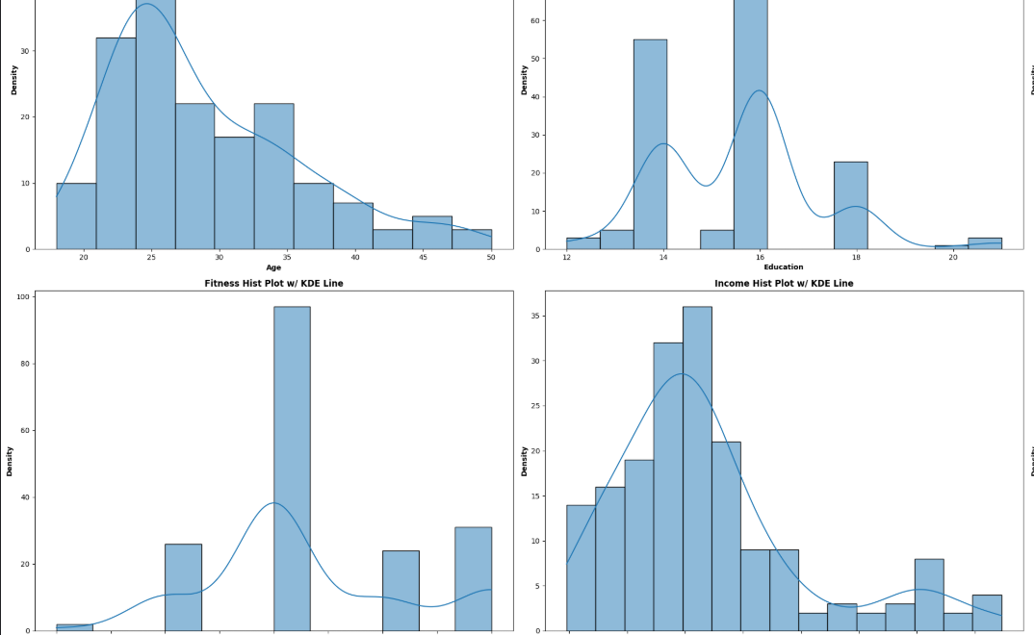
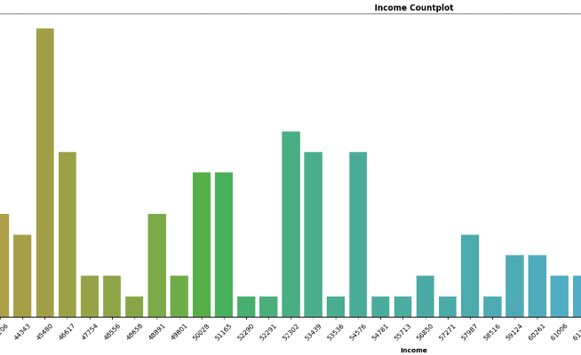
Data Exploration
Univariate Analysis
Explored key attributes such as age, income, gender, and product preference.
Visualized distributions.
Identified potential clusters of customers.
Key Learnings Preview:
Large subset of orders centered at ages 23-25
Fitness level 3 makes up large % or purchases
Majority of customer income between $40k - $60k
More Male customers than Female
More Partnered customers than Single

Slide 4
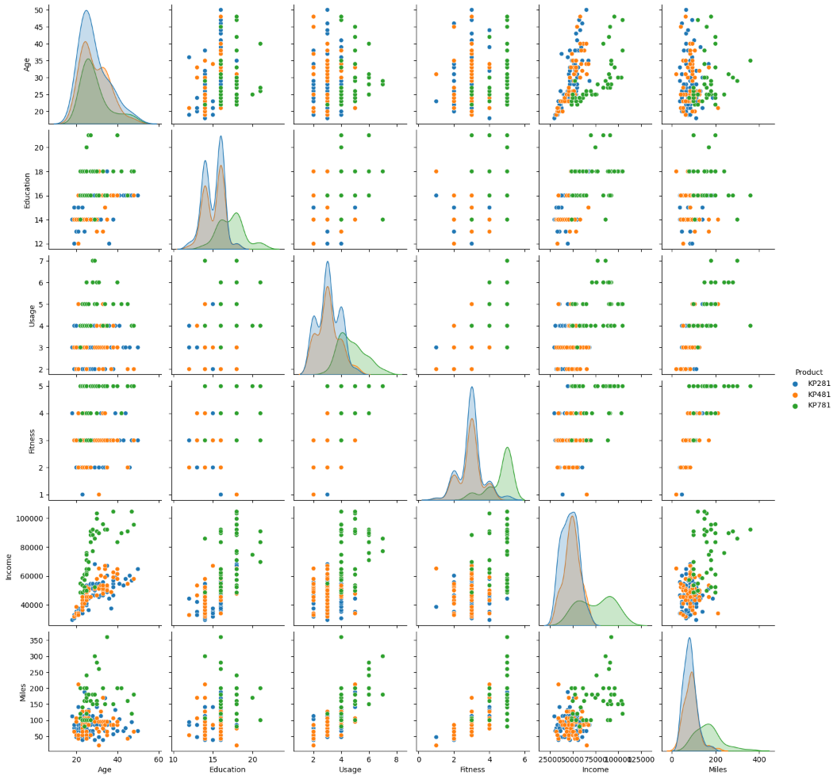
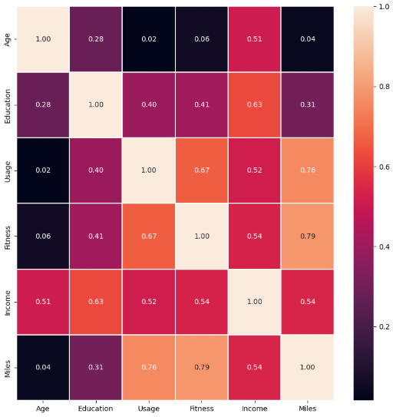
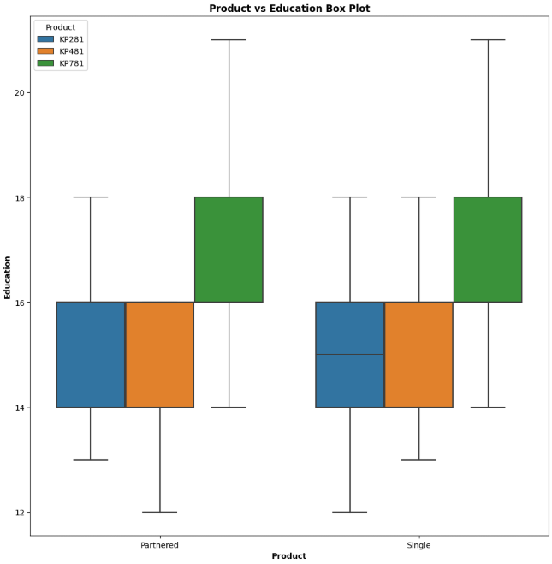
Data Exploration
Bivariate and Multivariate Analysis
Used clustering techniques to group similar buyers.
Identified distinct customer segments based on income and product preferences.
Provided insights into target demographics for marketing.
Key Learnings Preview:
50% of KP781 sales are by ages 25-30
Customers with Education <16 years are equally likely to purchase KP281 or KP481, >16 years are more likely to purchase KP781
KP781 purchases favor higher income, fitness level and miles per week
High Correlation Pairs: (Miles / Fitness) and (Miles / Usage)

Slide 5

Key Insights
Product KP281 is the best-selling with 44% of total purchases
The majority (83%) of treadmill customers fall within Lower-middle and Upper-middle income brackets ($35,000 to $85,000)
68% of purchases come from Lower-middle Income customers ($35,000 to $60,000)
Customers aged 20 to 40 make up ~88% of purchases
Miles and Fitness and Miles and Usage are highly correlated, meaning higher fitness levels are correlated with more treadmill use
KP781 stands out as the only model purchased by customers with Education above 20 years and Income over $70,000
With Fitness Level 4 and 5, Customers tend to utilize the KP781 when averaging 200 Miles or more per week

Slide 6
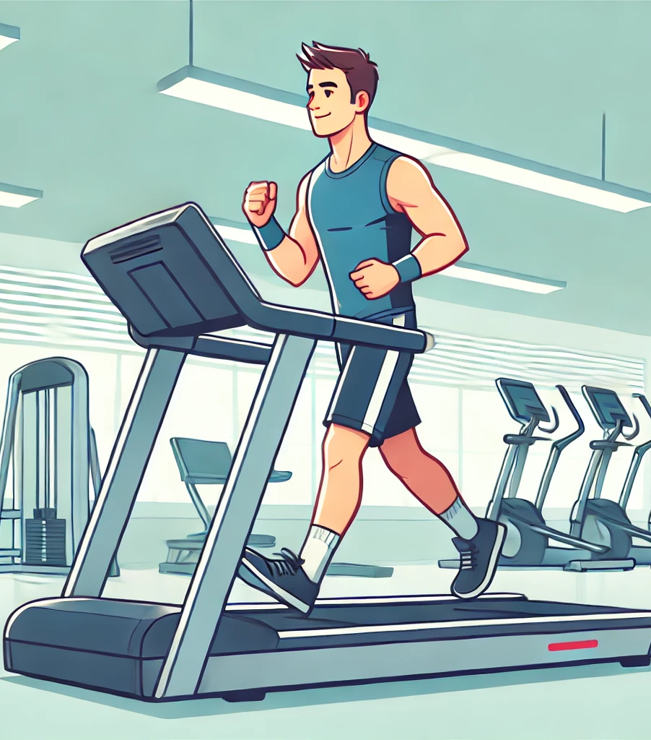
Recommendations
KP281 and KP481 are popular with customers within the income range of $35,000 - $60,000 and should be offered as budget friendly or affordable options
KP781 should be marketed as a premium / top tier product for high income earners with education over 20 years and high interest in fitness.
Aerofit should conduct research to see if it's product lines can attract incomes under $25,000 to expand its customer base
Aerofit may be able to gain market share in fitness locations (such as gyms) by leveraging demographic recognition of the brand as well, especially for the higher end fitness focused customers.

